Slide 1
Fundamentals of Programming
Lab – 10

Slide 2
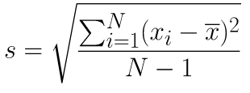
Task – 1
double array as argument and calculates standard deviation.
double stdDev(double arr[], int length){…}

Slide 3
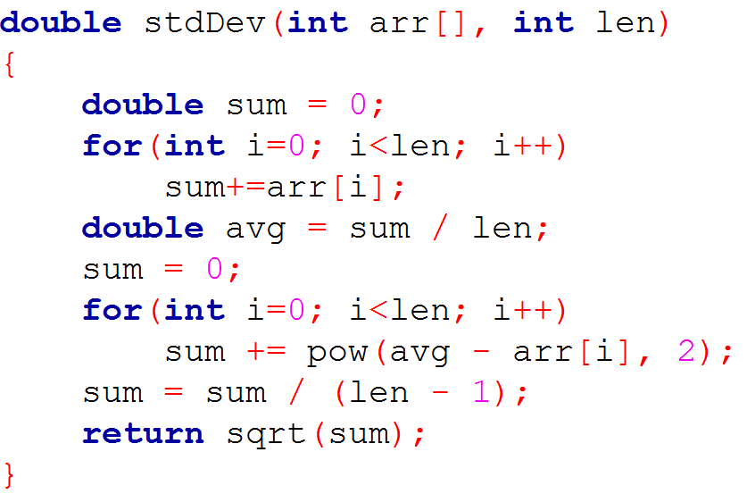
Task – 1
double array as argument and calculates standard deviation.
double stdDev(double arr[], int length){…}

Slide 4
Task – 2
two int arrays as arguments and returns True if both are identical (same elements in same order), otherwise returns False.
bool isEqual(int arr[], int brr[], int length){…}

Slide 5
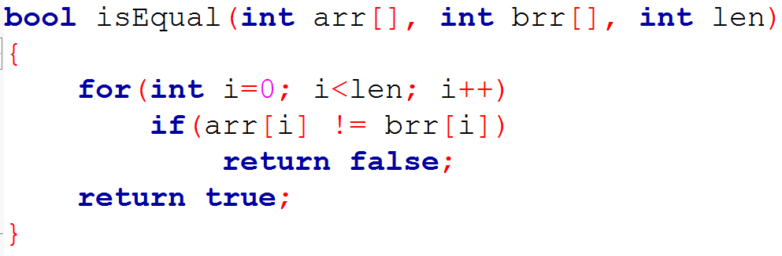
Task – 2
two int arrays as arguments and returns True if both are identical (same elements in same order), otherwise returns False.
bool isEqual(int arr[], int brr[], int length){…}

Slide 6
Task – 3
one int array as argument and returns True if all numbers from 0-10 are present in the array, otherwise returns False.
bool isAllPresent(int arr[], int length){…}

Slide 7
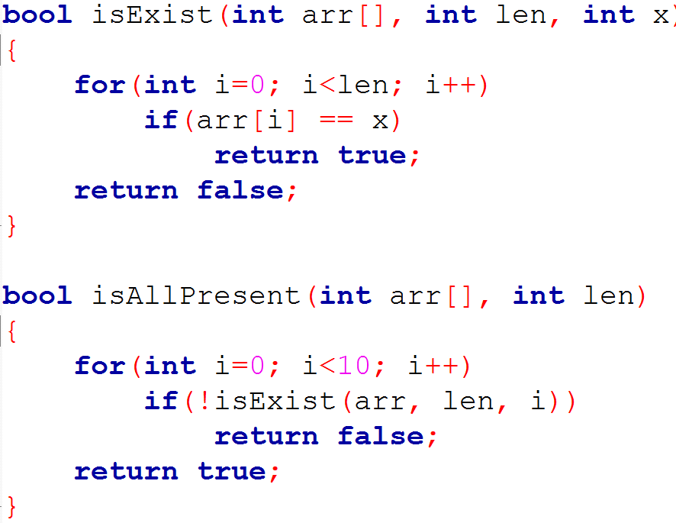
Task – 3

Slide 8
Task – 4
one float array as argument and returns True if all numbers present in the array are in Ascending order, otherwise returns False.
bool isAscending(float arr[], int length){…}

Slide 9
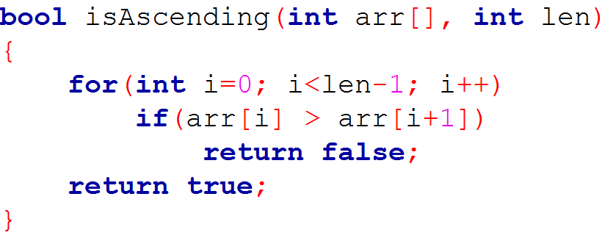
Task – 4
one float array as argument and returns True if all numbers present in the array are in Ascending order, otherwise returns False.
bool isAscending(float arr[], int length){…}

Slide 10
Task – 5
one int array as argument and prints only distinct elements of the array.
void printsDistinct(int arr[], int length){…}

Slide 11
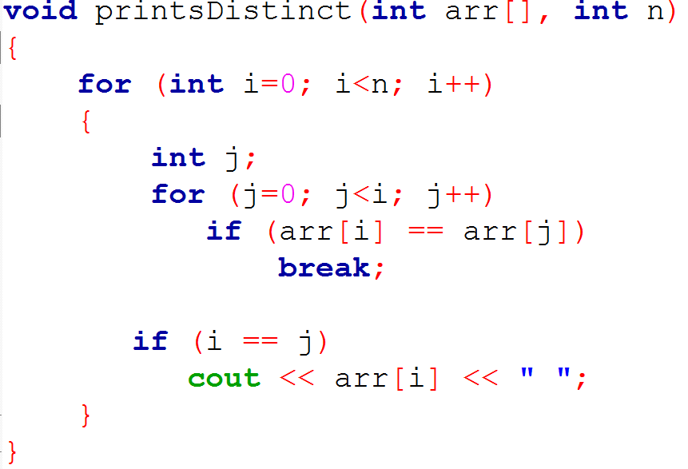
Task – 5

Slide 12
Task – 6
three int arrays of length 10 as argument, and stores common elements of the first two arrays in the third array.
void commonElements(int arr[], int brr[], int result[]){…}

Slide 13
Task – 6
three int arrays of length 10 as argument, and stores common elements of the first two arrays in the third array.
void commonElements(int arr[], int brr[], int result[]){…}

Slide 14
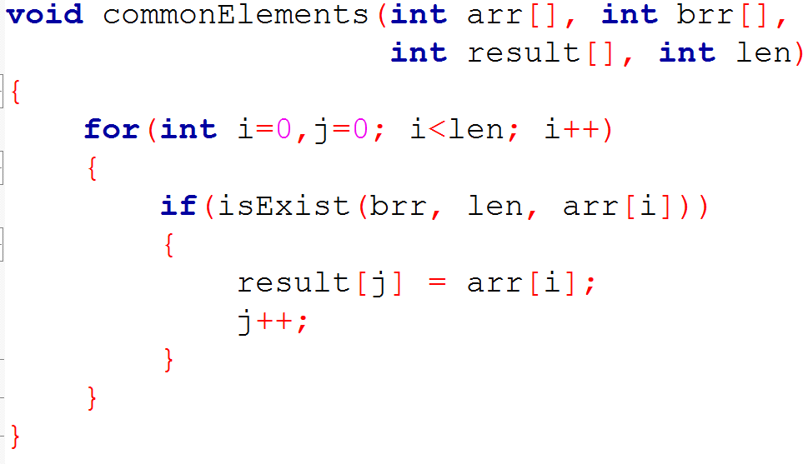
Task – 6

Slide 15
Task – 7
a character array as argument and converts it to an integer in base 8 (octal).
int toBase8(char arr[], int length){…}

Slide 16
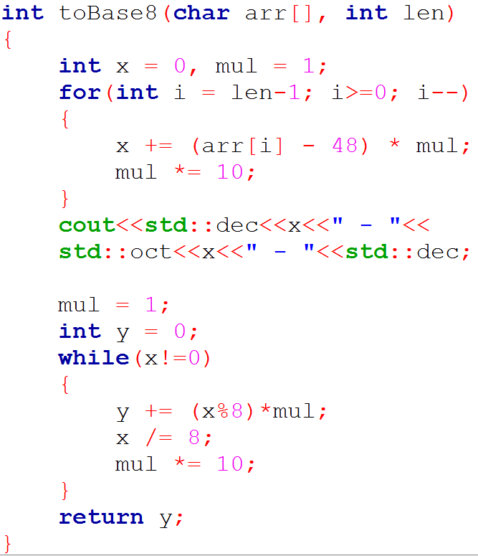
Task – 7

Slide 17
Task – 7

Slide 18
Task – 8
a character array as argument and returns number of vowel character in the string.
int countOfVowels(char arr[], int length){…}

Slide 19
Task – 9
a string as argument and returns the word count
int wordCount(string s){…}
Hint: Each word is often separated by a space character. But simply counting the number of space characters may produce the wrong answer.

Slide 20
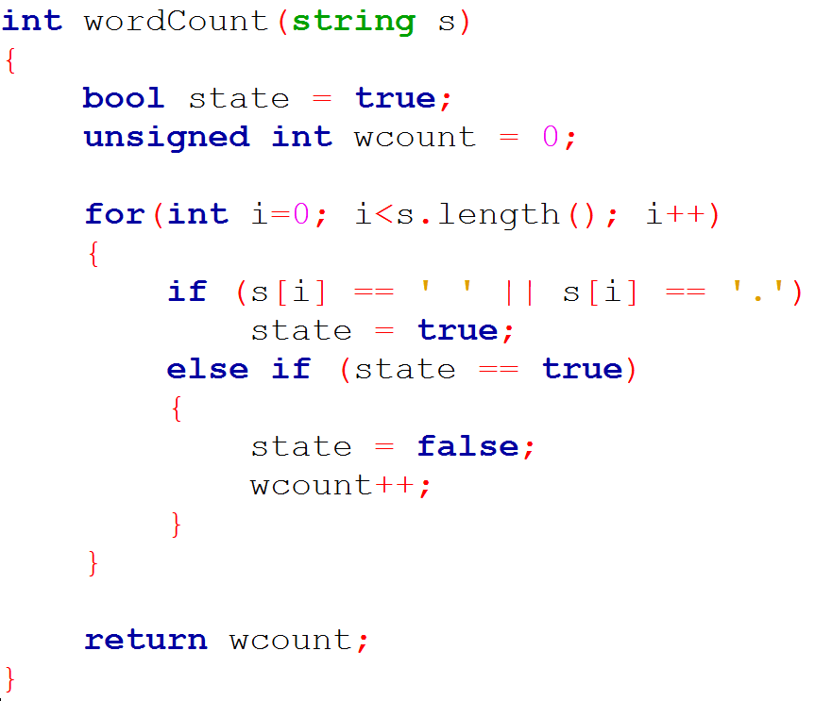
Task – 9

Slide 21
Task – 10
a string and a character array as arguments and returns length of the longest word in the string and copies the longest word in the character array.
int maxWord(string s, char longWord[]){…}

Slide 22
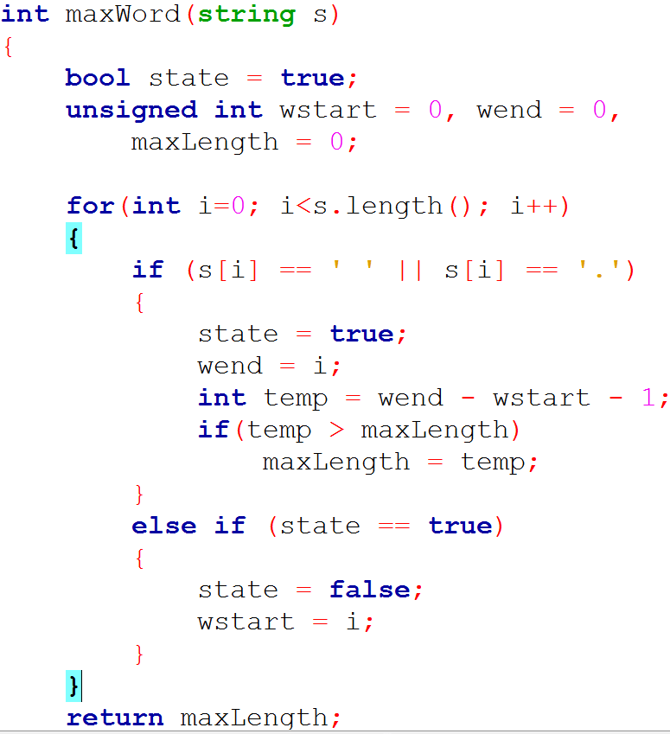

Slide 23
Task – 11
a string and an int array as argument and stores the frequency of the characters in int array
void charFrequencyt(string s, int freq[]){…}
For example, the number of times character ‘a’ or ‘A’ appears in the string s, should be stored at index 0 in the freq array.

Slide 24
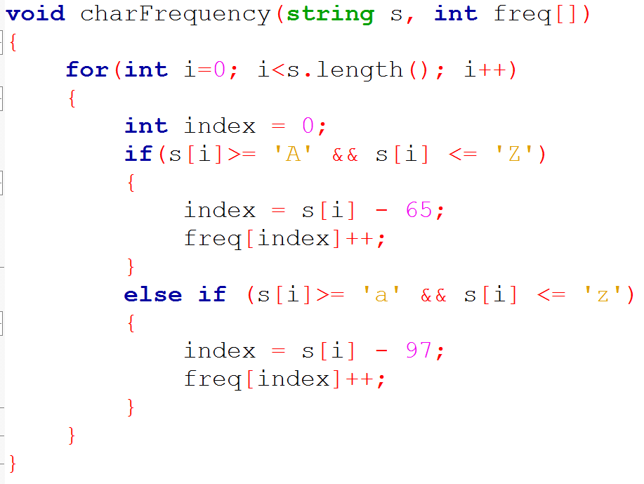
Task – 11

Slide 25
Task – 12
a string as argument and prints all the double occurrences of the same character.
void doubleOccour(string s){…}
E.g: For the string “The committee was brilliant.” Output should be mm-tt-ee-ll-

Slide 26
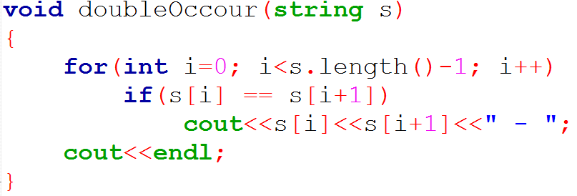
Task – 12
a string as argument and prints all the double occurrences of the same character.
void doubleOccour(string s){…}
E.g: For the string “The committee was brilliant.” Output should be mm-tt-ee-ll-

Slide 27
Task – 13
two string arguments and finds number of times the second string appears in the first string
int findCount(string s1, string s2){…}
E.g: Let s1 = “This is a cat and that is a dog.” and s2 = “is”, then function should return 3.

Slide 28
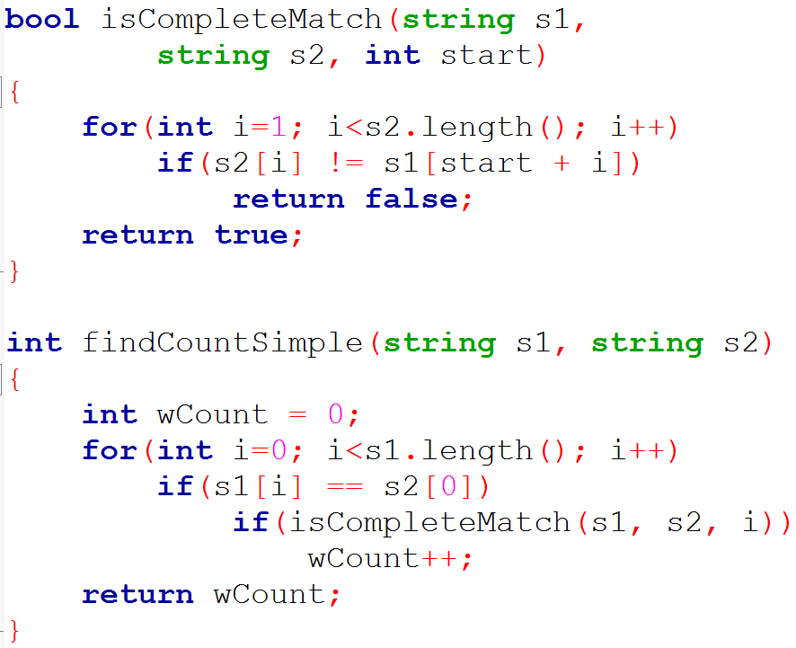
Task – 13

Slide 29
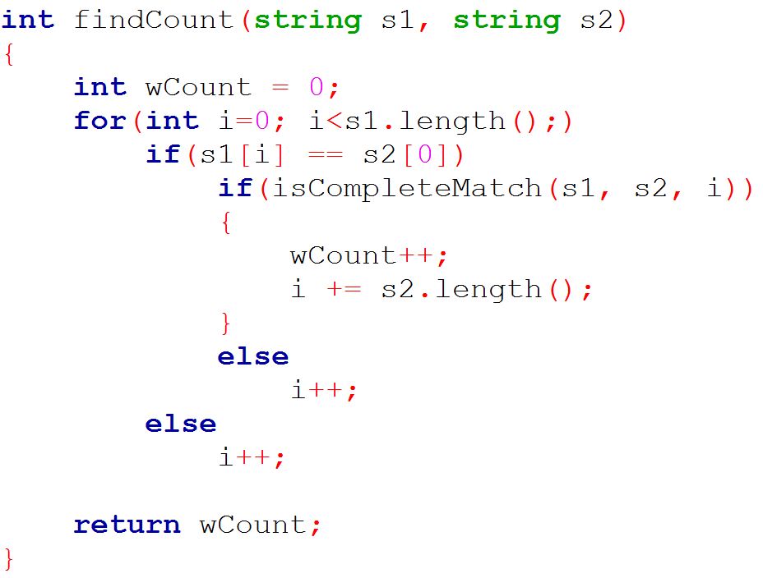
Task – 13

Slide 30
Thanks

